Slide 1
Preparing Open Educators Essential Conceptual Understandings & Proficiencies
Gail Matthews-DeNatale
Lecturer, CPS Graduate School of Education
Senior Associate Director, CATLR

Slide 2
Poll: Open Education (a.k.a. Open Learning)
General idea and interest, but no prior experience
I’ve integrated open education into my credit-bearing teaching practice
I’ve helped other educators learn about and integrate open education into their practice
Have integrated open education into my practice and helped other educators

Slide 3
Outcomes
During the session you will consider:
Philosophical ideas and principles essential to open learning
Essential open educator proficiencies (concepts and practices)
Open educator proficiencies that are most relevant to your context
In Companion ePortfolio you will access:
Collection of concrete strategies, exemplars, materials
Bibliography of sources that informed the framework of proficiencies

Slide 4
Open Education: Big Idea
Philosophy Education can only achieve its full potential if knowledge is shared, therefore the products of learning and teaching should be a common good.
Resources
Practices
Software

Slide 5
Open Learning: Principle
“Engage with students as creators of information rather than simply consumers of it. [Open Learning] is a form of experiential learning in which students demonstrate understanding through the act of creation.”
Hegarty, 2015; Cook-Sather et. al., 2014; OAResources, 2019

Slide 6
Open Educators: Scope of Practice
Open Educators
Open Education
Open Learning

Slide 7
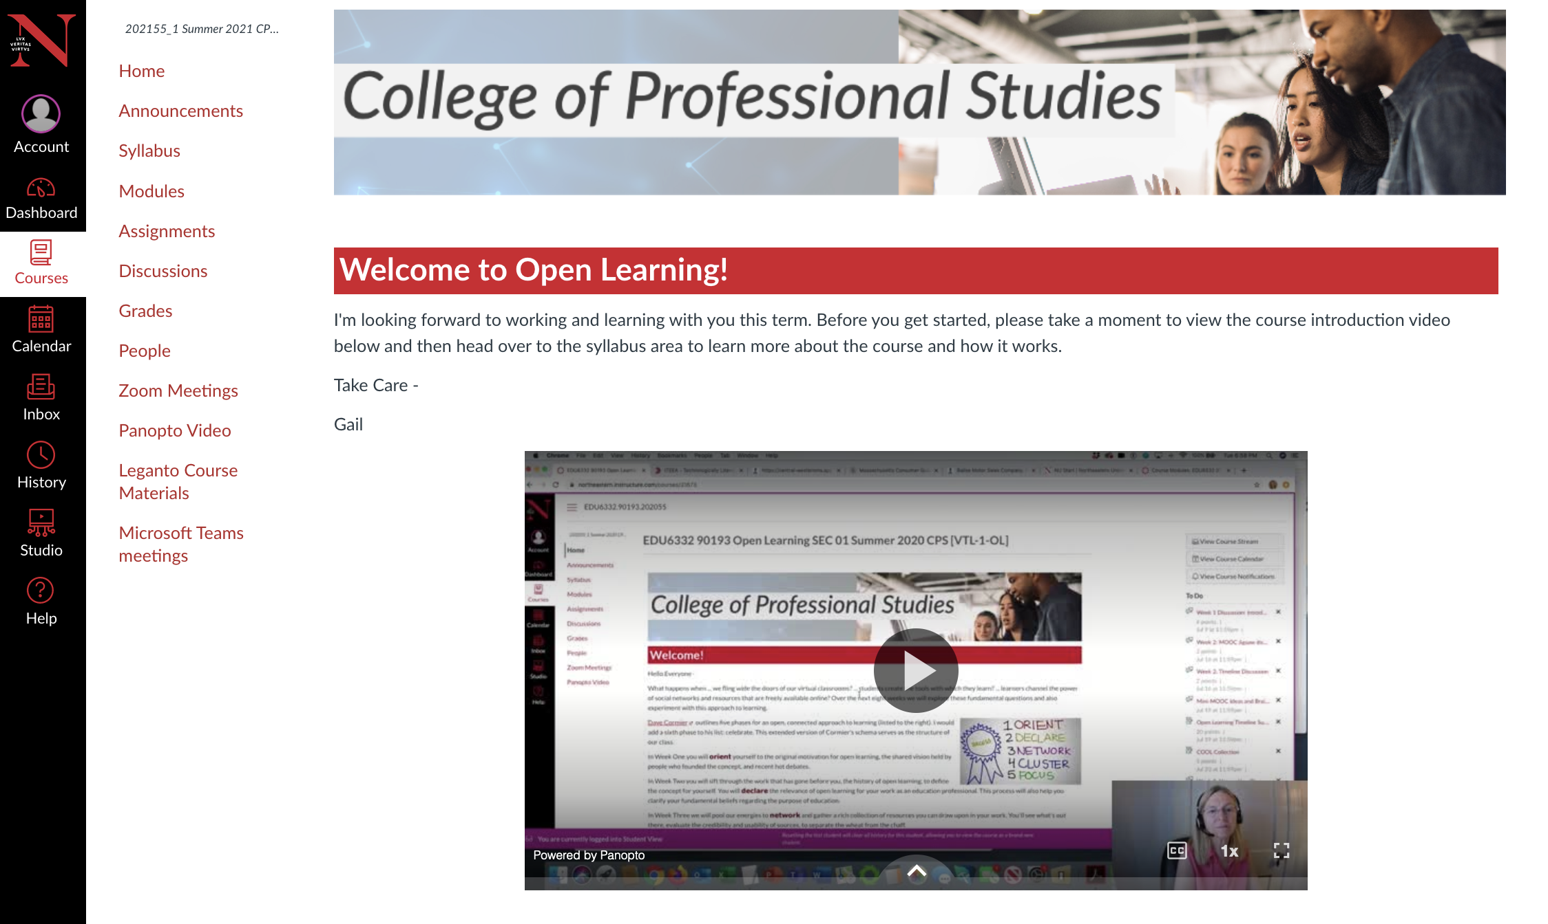
Teaching Context

Slide 8
Articulating Priorities (In the Chat)
If you were teaching or taking a graduate-level education course titled “open learning,” what would you expect to course participants to learn?

Slide 9
Proficiencies: Concepts, Principles, Practices
P1: Origins and Context
P2: Information Fluency
P3: Curation
P4: Learning Experience Design
P5: Education Technology
P6: Open Pedagogy
(ELI, 2018; García-López et. al, 2017; Mabiala, 2016; Petrides et al, 2018)
Notes:
Note that many frameworks that informed my identification of these particular proficiencies

Slide 10
The Proficiencies (In the Chat)
P1: Origins and Context
P2: Information Fluency
P3: Curation
P4: Learning Experience Design
P5: Education Technology
P6: Open Pedagogy
Which proficiencies were expected? Why?
Which, if any, proficiencies surprise you? Why?
Which ones are intriguing, but less clear for you? [Examples will follow]

Slide 11
P1: Origins and Context
P1: Origins and Context
P2: Information Fluency
P3: Curation
P4: Learning Experience Design
P5: Education Technology
P6: Open Pedagogy
Identify the diverse roots of Open Learning as a movement, especially those that are most relevant to your interests and needs as an educator.

Slide 12
P1: Origins and Context
Essential Understanding Open education is not a fad. It builds on centuries of work by educators and technical innovators.
Timeline Assignment
How far back does the concept of "openness" go? What are the big ideas?
What have been the major developments? Who was involved? In what sectors?
(Timelines by Imick McCray and Angel Byars)

Slide 13
Origins & Context: Student Reflections
S1: “Heading into this course I thought I understood what open learning meant, but soon realized I really had no idea of how big a concept this is and how long it has been evolving. What has really stuck with me throughout the is the basic idea of generosity … How exciting is that?”
S2: “Our timeline assignment made me realize there are theories, frameworks, influential people, and large-scale actions that set open learning in motion.”

Slide 14
P2: Information Fluency
P1: Origins and Context
P2: Information Fluency
P3: Curation
P4: Learning Experience Design
P5: Education Technology
P6: Open Pedagogy
Locate, evaluate, and select high quality open education resources that are most relevant to a given teaching scenario (preferably something that you or a constituent currently teach, or an offering your program would like to develop).

Slide 15
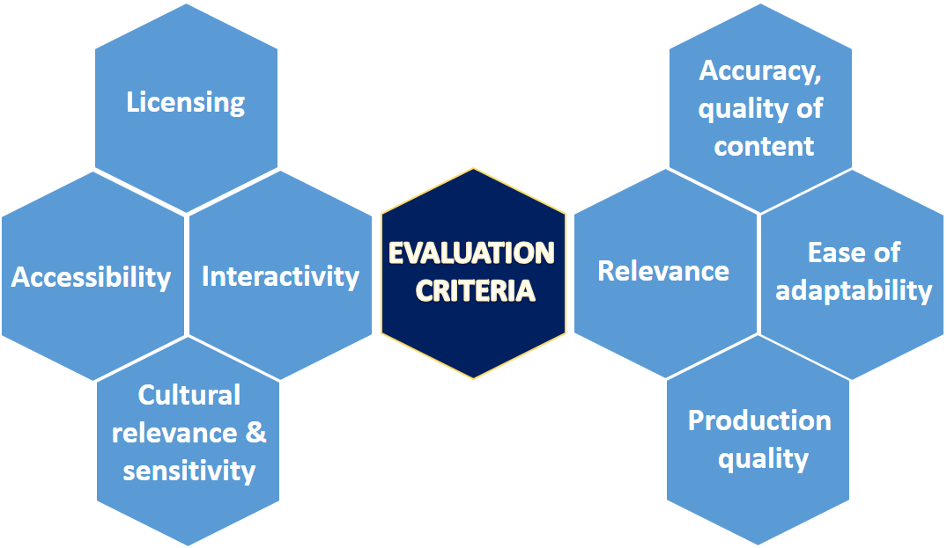
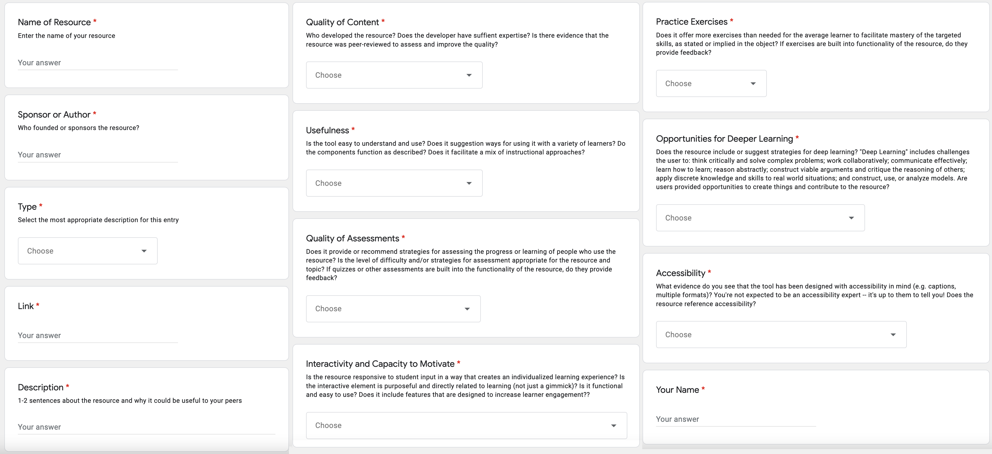
P2: Information Fluency
Essential Understanding There are many elements that need to be considered when evaluating OER.
Crowdsourced Open Online Learning (COOL)
Identify a course scenario or topic
Look for relevant OERs
Evaluate and pool OERs
(NUS Libraries, 2021; TEMOA, 2011; Achieve, 2011)

Slide 16
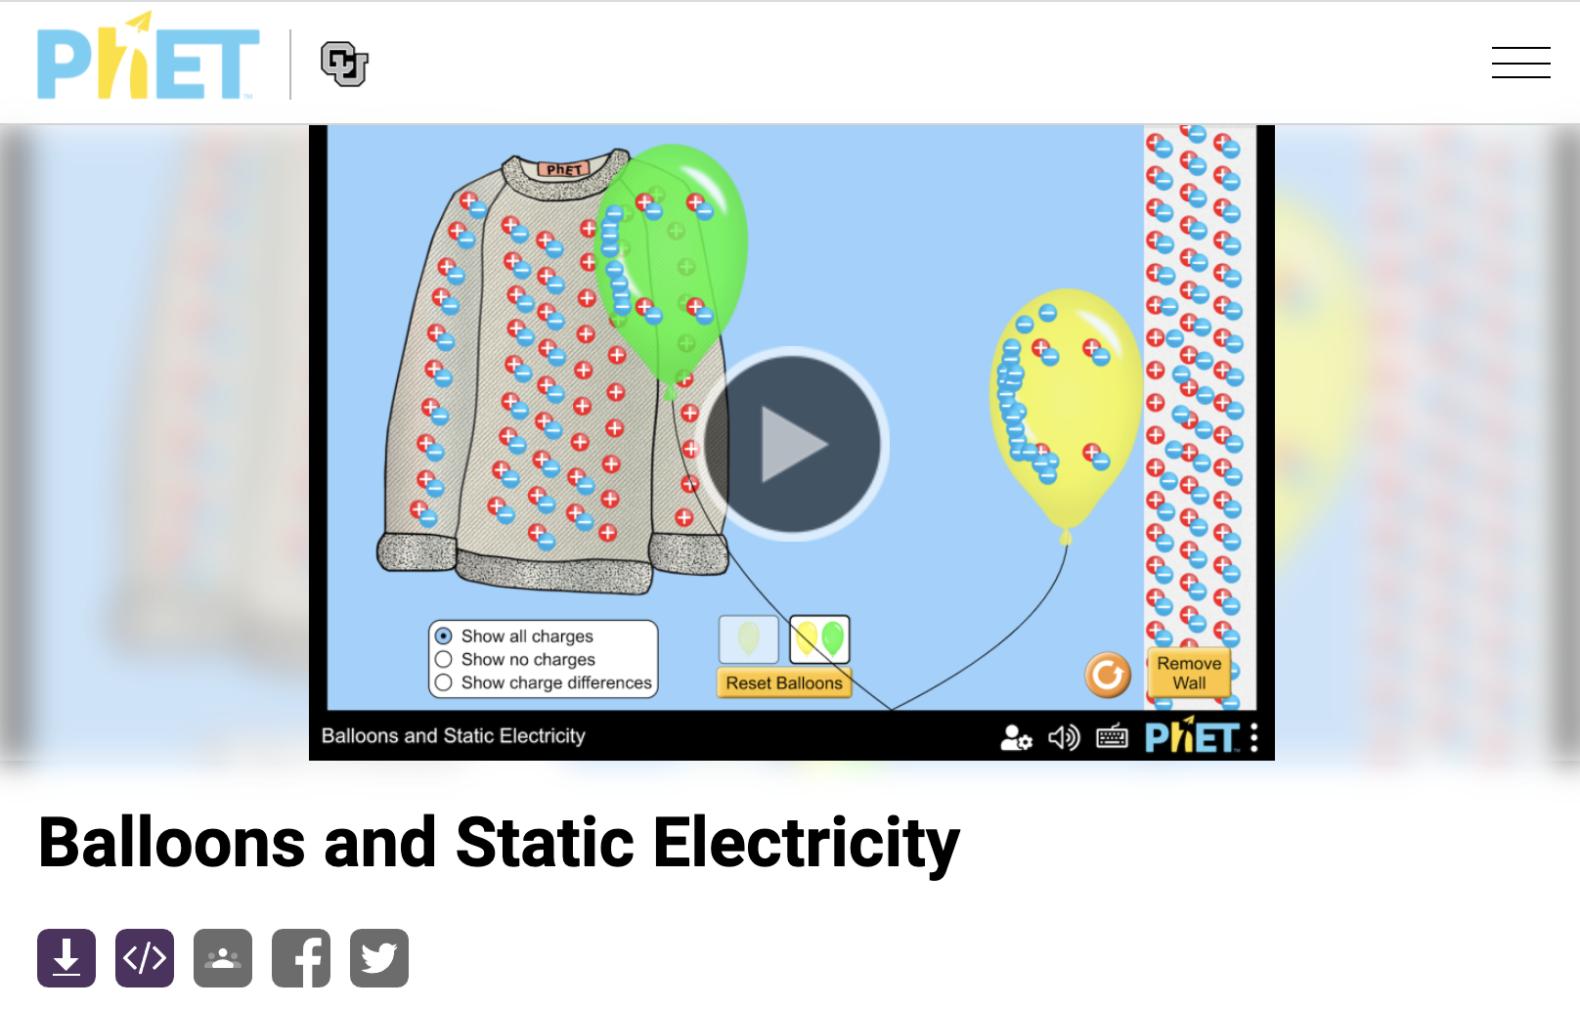
P2: Information Fluency
Essential Understanding There are many elements that need to be considered when evaluating OER.

Slide 17
Information Fluency: Student Reflection
S2: “In the first week we were asked to post a reflective response to a video by David Wiley. My first response came from a place of defensiveness and closed mindedness. Why should educators be expected to share their intellectual property with others for free?
I started to see that open education and its history is far more complex … a network of ideas that allows for more equitable educational experiences for so many people.”

Slide 18
P3: Curation
P1: Origins and Context
P2: Information Fluency
P3: Curation
P4: Learning Experience Design
P5: Education Technology
P6: Open Pedagogy
Identify the desired learning outcomes of a specified teaching scenario. For each outcome, curate an intentional and strategic collection of OERs that are most relevant to to the goals for learning.

Slide 19
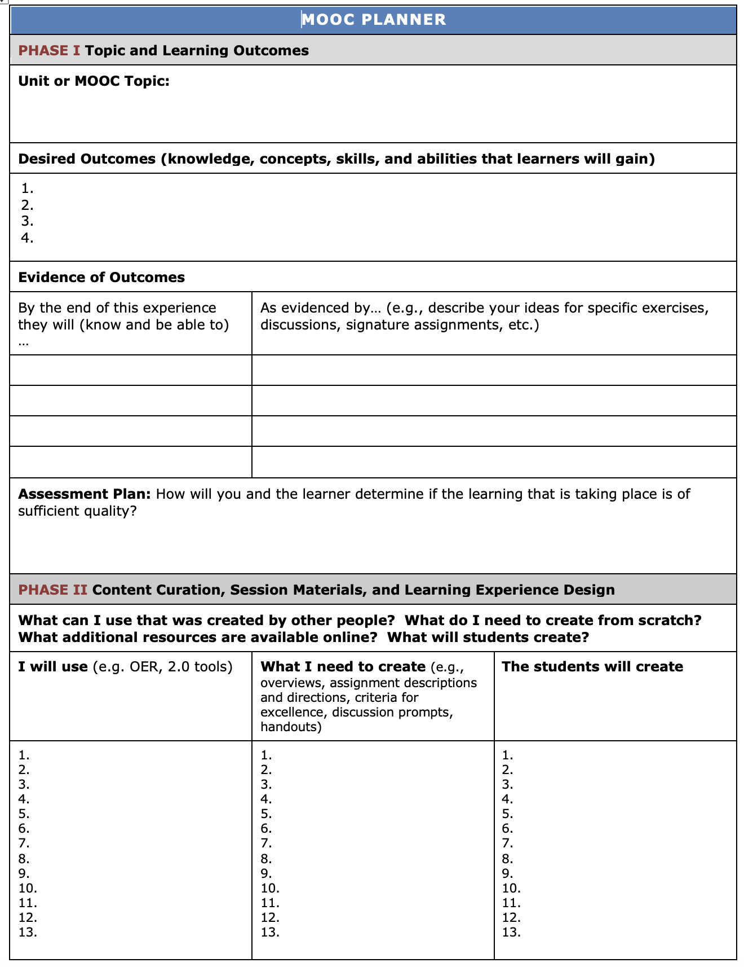
P3: Curation
Essential Understanding The OER integration process is nonlinear, iterative, and strategic. A preliminary scan can spark ideas for teaching. Selection involves winnowing and adapting resources in relation to goals.
Mini-MOOC (plan 2-week learning experience)
Individual choice of topic
Topic selected the same week of COOL
Process guided by a multi-week planner
Buddy triads provide feedback
Content includes at least three forms of high-quality open learning resources that were created by another entity (e.g., materials, videos, tools)

Slide 20
Curation: Student Reflection
S3: “In a field constantly striving for innovation, Open Education Resources provide a tangible record of content and pedagogy that allows us as educators to continue to reform and improve, providing better education to students around the world for years to come.”

Slide 21
P4: Learning Experience Design
P1: Origins and Context
P2: Information Fluency
P3: Curation
P4: Learning Experience Design
P5: Education Technology
P6: Open Pedagogy
(Re)design a two-week online learning experience, integrating/adapting OERs that support and further the learning outcomes. Author/refine original collateral materials such as assignments.

Slide 22
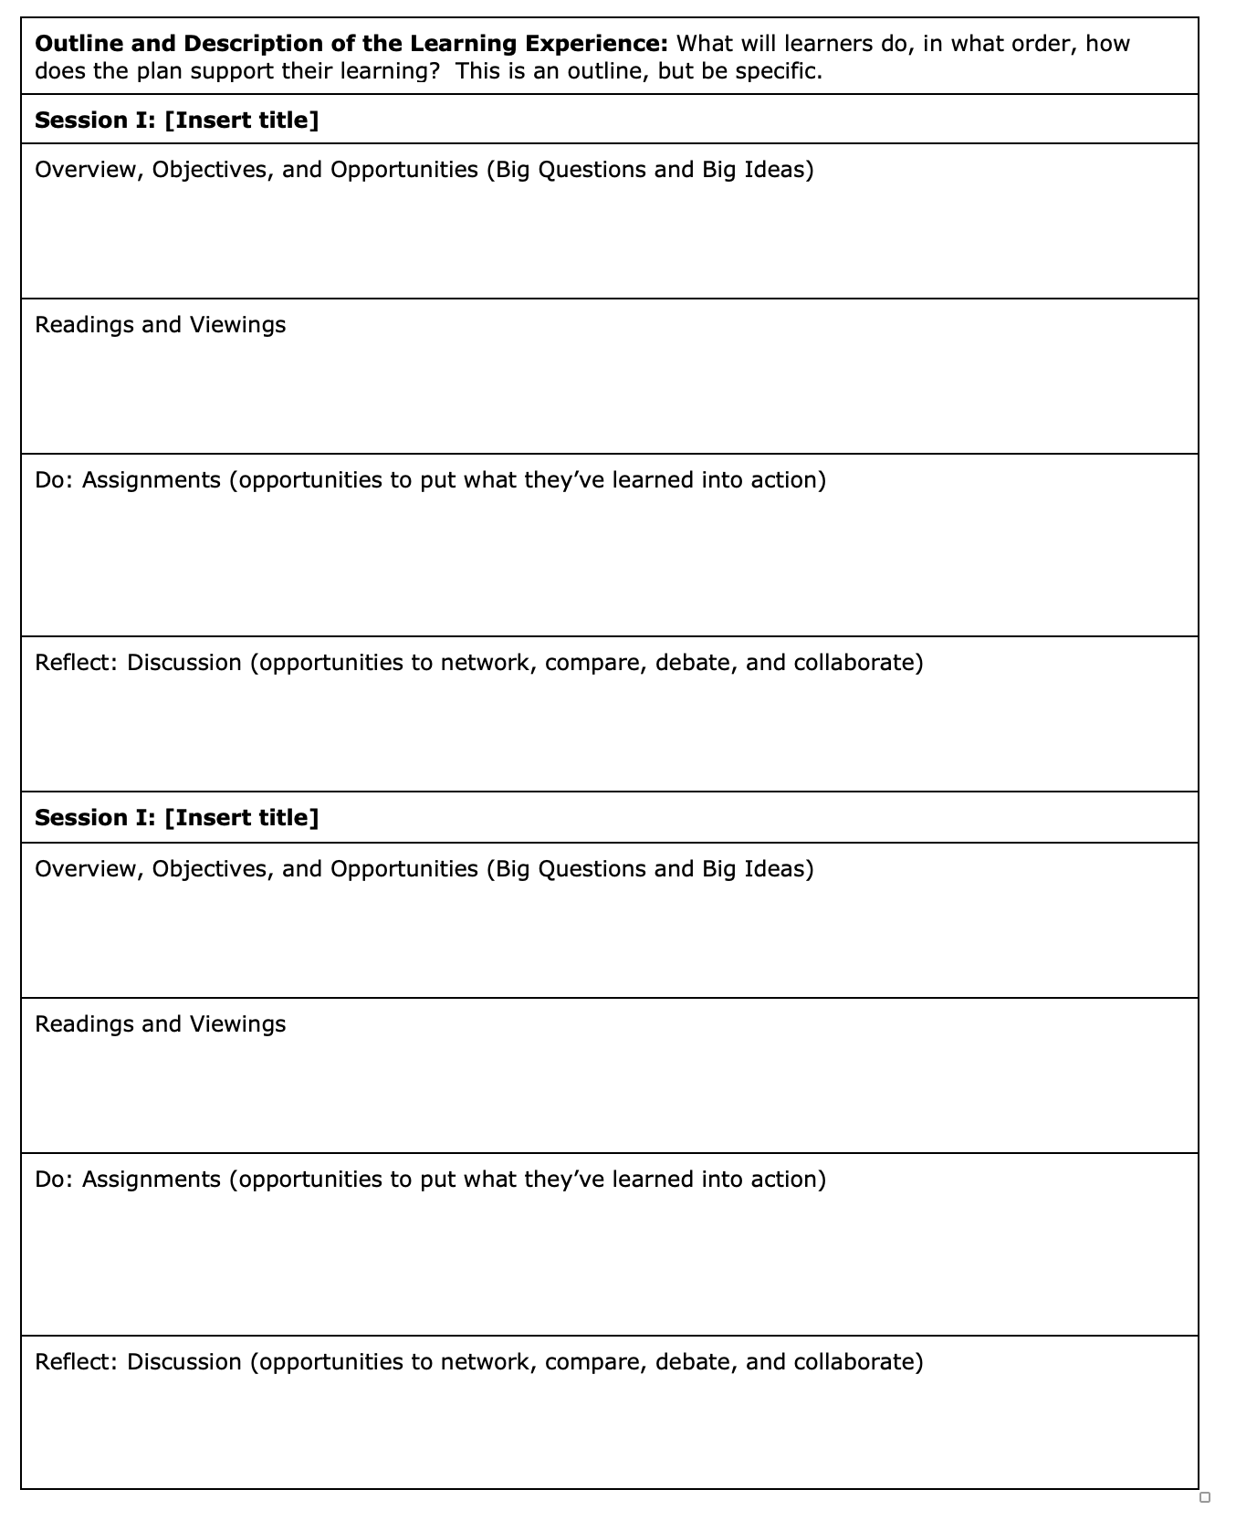
P4: Learning Experience Design
Essential Understanding Active learning is engaging, but it needs to be purposeful to accomplish goals. A good experience is a gratifying journey in which each part contributes to the whole.
Mini-MOOC (plan 2-week learning experience)
Reflect on buddy feedback input, note and share how you acted upon it and why.
Engage your learners in content (read/view), intentionally designed activities (do), and metacognition (reflect)
Content includes at least two substantive open learning resources created by you

Slide 23
Learning Experience Design: Student Reflection
S4: “I really didn't know what to expect. [When I found out about the Mini-MOOC assignment] I thought ‘I can't do that. That's too much.’
I’d call it a guided creativity. It wasn't, ‘These are the five learning resources that you're supposed to put in your MOOC and put them in a certain order.’ ... It was just so much more than that. There are parameters that you gave … but they were broad enough that I had free rein.”
As the course went on, I got a better picture of what Open Learning really was … [OERs] helped give the meatiness to the course.”

Slide 24
P5: Education Technology
P1: Origins and Context
P2: Information Fluency
P3: Curation
P4: Learning Experience Design
P5: Education Technology
P6: Open Pedagogy
Stage an OER-integrated learning experience in an online learning platform. Make effective use of media and interactive technologies to deepen and further the learning experience. Assign CC license to original materials developed.

Slide 25
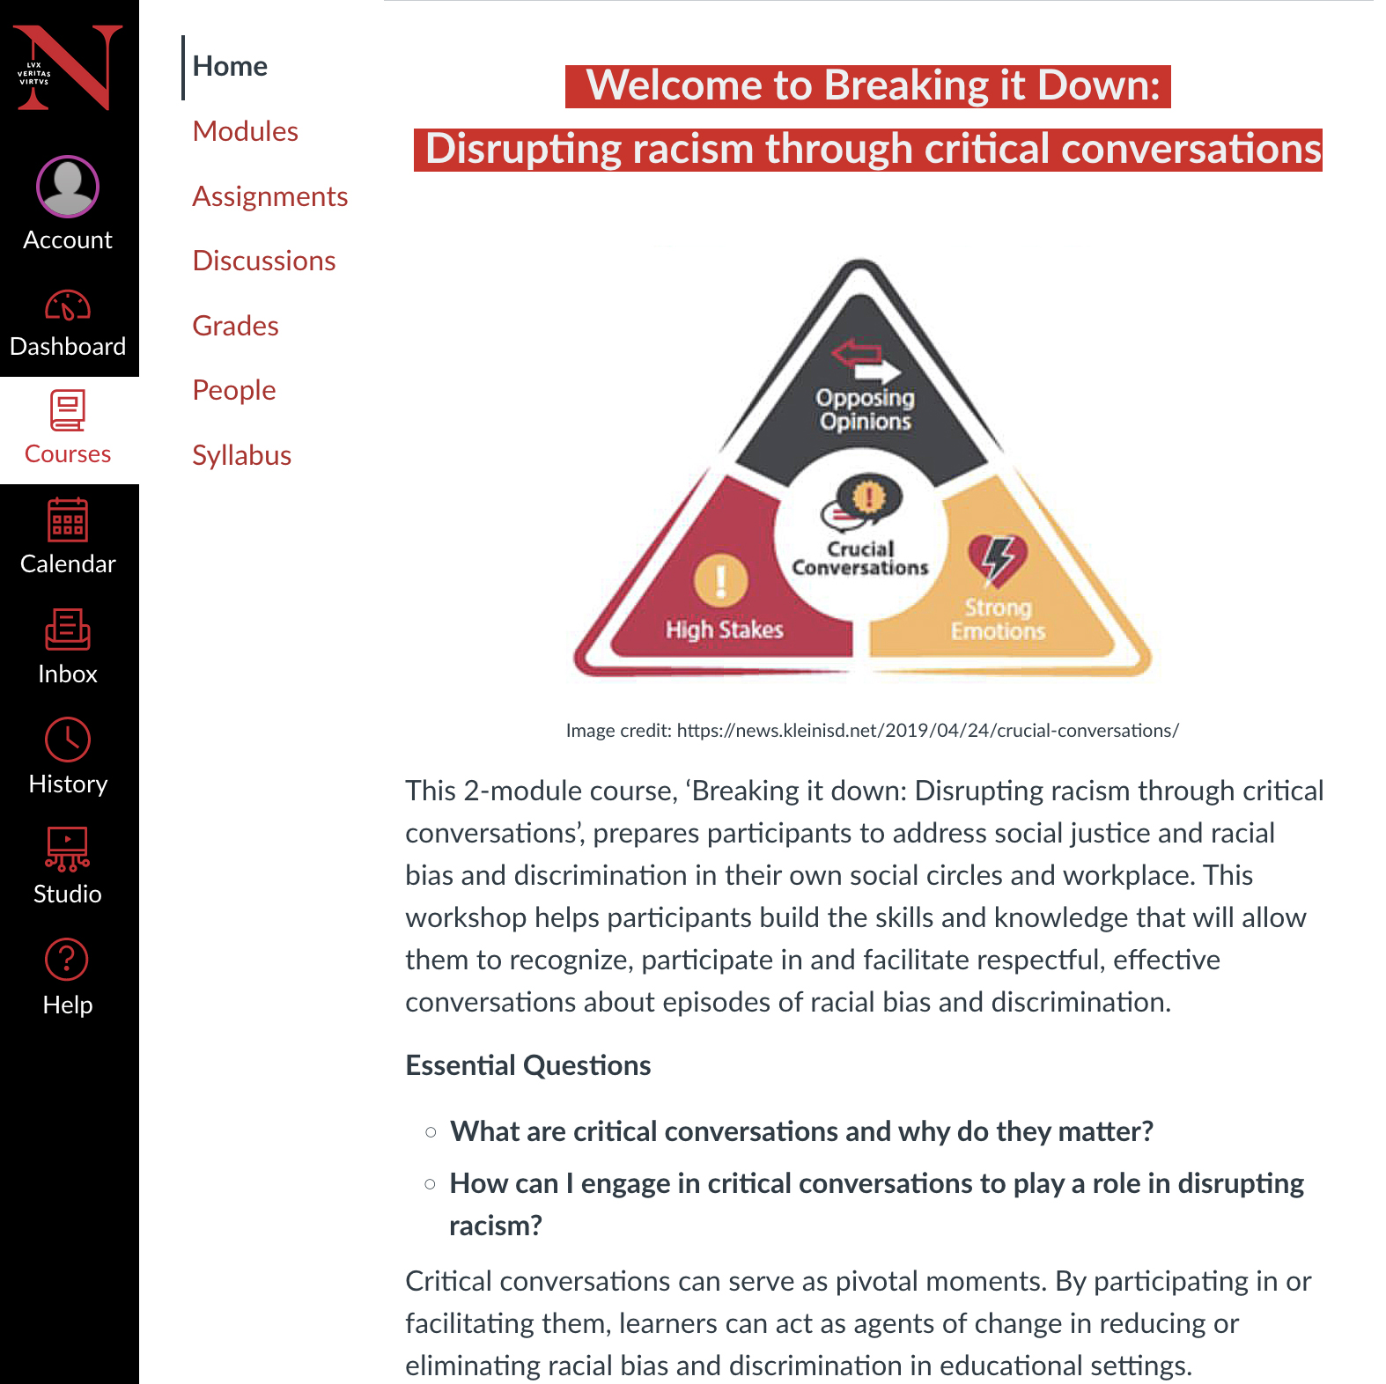
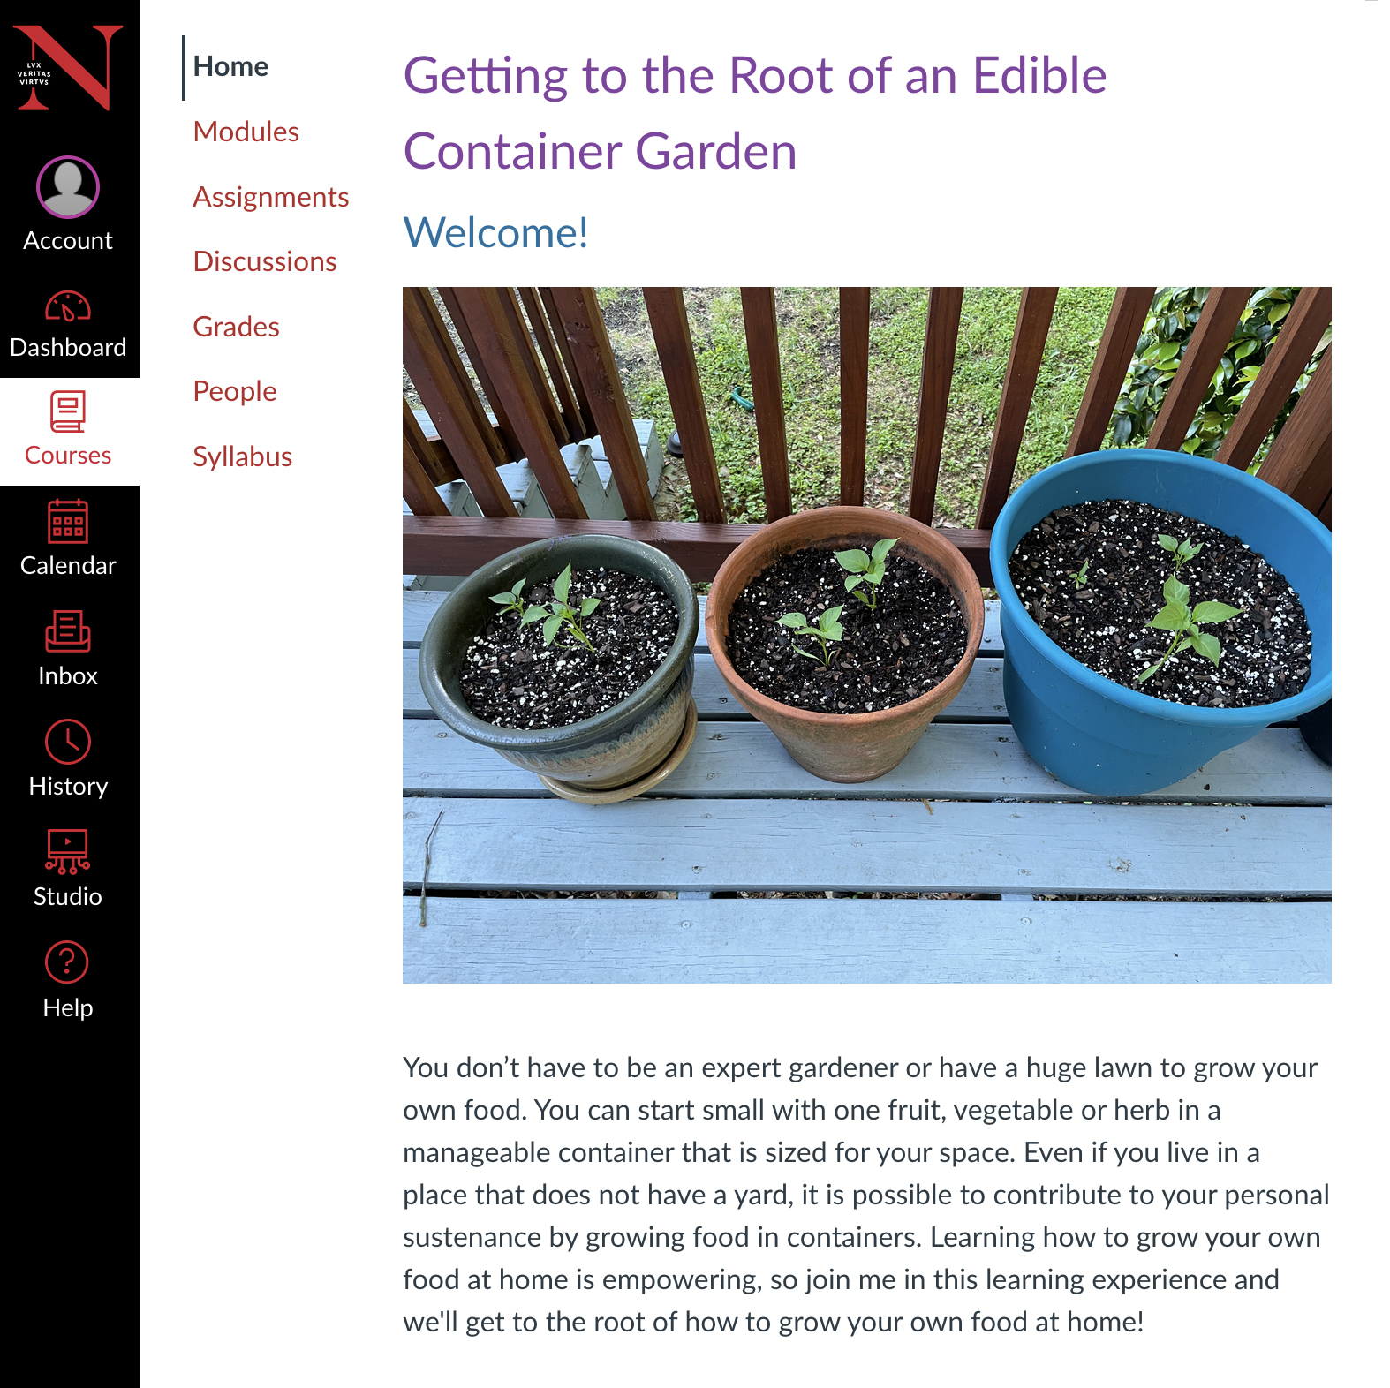
P5: Educational Technology
Essential Understanding While LXD is more important than technology, effective implementation is critical. Creative yet purposeful use of technology increases engagement.
Mini-MOOC (plan 2-week learning experience)
Each student provided with their own Canvas course. In previous terms they had the option to stage it in other platforms.
Students encouraged to share strategies, mentor each other in use of tools.
Make effective use of multimedia that combines images, words, and sound. Cite all sources.
Assign a Creative Commons license and set for self-enrollment

Slide 26
Education Technology: Student Reflection
S5: “I was challenged to be creative with using OERs to build something new. It was eye opening to see the many elements that go into creating an effective online course from scratch. I never thought I would have the skills to build one myself, and I am proud of what I built. I have been able to expand my knowledge of what it means to take ownership of your work and the power to share it with others. ”

Slide 27
P6: Open Pedagogy
P1: Origins and Context
P2: Information Fluency
P3: Curation
P4: Learning Experience Design
P5: Education Technology
P6: Open Pedagogy
Facilitate a two-week, active, online participatory learning experience that incorporates OERs and engages learners in the development of authentic products that can be shared with others (have value beyond the class).

Slide 28
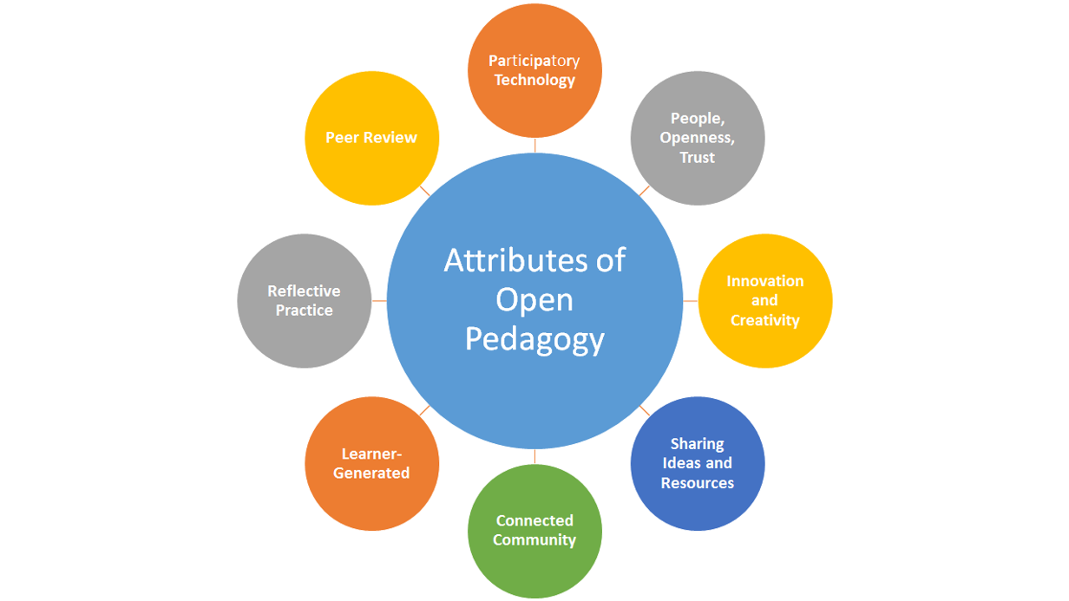
P6: Open Pedagogy
Essential Understanding Roles between educators and student can be fluid; partnership increases a sense of mattering and empowerment. Teaching, and the improvement of teaching, is iterative.
Mini-MOOC
Run the MOOC with your buddies in the final two weeks of the course. They and your course instructor role play being students in the class.
Buddy Feedback Form is provided in a template that aligns with Min-MOOC assignment rubric.
(Paskevivius, M, 2017; Hegarty, 2018; Cool-Sather et. al 2014)

Slide 29
Open Pedagogy: Student Reflection
S6: “This class’s format made us comment on each other’s work in a way that required the recipient to do something. I am not saying I had to make the changes, but I really had to reflect on the comments. As much as I want to say my biggest take away was making the MOOC, it really wasn’t. My biggest takeaway was the power of someone else’s point of view.”

Slide 30
Final Reflections on Course Learning
S7: “This course has fundamentally shifted the way I view the field of education.”
S8: “I feel this is the most I have changed since beginning my master’s program. The feedback from peers … helped me understand the material, assignments, and that I wasn’t alone.”
S9: “I plan to make the educational materials I create openly available to give back to the OER community … To design authentic and engaging learning experiences, I have to leverage and collaborate with the open learning community.”

Slide 31
Revisiting Early Questions (In Chat/Verbally)
How might Open Educator Proficiencies inform your teaching and/or faculty development practice?

Slide 32
Questions and Comments?
Thank you!
Access the companion ePortfolio at https://openeducators.sites.northeastern.edu

Slide 33
References
Cook-Sather, A., Bovill, C., Felten, P. (2014). Engaging students as partners in learning and teaching: A guide for faculty. Jossey-Bass.
ELI. (2018). 7 things you should know about open education: Content, practices, policies. https://library.educause.edu/resources/2018/6/7-things-you-should-know-about-open-education-content
Hegarty, B. (2015). Attributes of open pedagogy: A model for using open educational resources. Educational Technology, 55(4). https://www.jstor.org/stable/44430383
García-López, R.-I., Salazar, O. C., Ramírez-Montoya, M.-S., & Tenorio-Sepúlveda, G.-C. (2017). Competencies for production, search, diffusion and mobilization of open educational resources. International Education Studies, 10(4), 78. https://doi.org/10.5539/ies.v10n4p78
Mabiala, M. (2016). Open education resources competency framework. Organisation Internationale de la francophone. https://ifadem.org/sites/default/files/divers/livret-rel-eng-web_0.pdf
OAResources. (2019, February 25) Open pedagogy. https://oaresources.org/open-pedagogy/
Paskevivius, M. (2017, September 12). Design attributes of open pedagogy by Bronwyn Hegarty. The non-disposable assignment: Enhancing personalized learning. https://wordpress.viu.ca/enhancingpersonalizedlearning/2017/09/12/design-attributes-of-open-pedagogy-by-bronwyn-hegarty/
Petrides, L., Levin, D. Watson, C. E. (2018) Toward a sustainable OER ecosystem: The case for OER stewardship. https://careframework.org/

Slide 34
Proficiency Definitions
P1: Origins and Context: Identify the diverse roots of Open Learning that are most relevant to your interests and needs as an educator.
P2: Information Fluency: Locate, evaluate, and select high quality open education resources that are most relevant to a given teaching scenario (preferably something that you or a constituent currently teach, or an offering your program would like to develop).
P3: Curation: Identify the desired learning outcomes of a specified teaching scenario. For each outcome, curate an intentional and strategic collection of OERs that are most relevant to to the goals for learning.
P4: Learning Experience Design: (Re)design a two-week online learning experience (i.e., unit or module), integrating/adapting OERs that support and further the learning outcomes. Author/refine original collateral materials such as assignments.
P5: Education Technology: Stage an OER-integrated learning experience in an online learning platform. Make effective use of media and interactive technologies to deepen and further the learning experience. Assign CC license to original materials developed.
P6: Open Pedagogy: Facilitate a two-week, active, online participatory learning experience that incorporates OERs and engages learners in the development of authentic products that can be shared with others (have value beyond the class).

